Slide 1
observables
Observables provide support for passing messages between publishers and subscribers in your application. Observables offer significant benefits over other techniques for event handling, asynchronous programming, and handling multiple values
What is an Observable in Angular
Observable is a function that converts the ordinary stream of data into an observable stream of data. You can think of Observable as a wrapper around the ordinary stream of data.
Observable stream or simple Observable emits the value from the stream asynchronously. It emits the complete signals when the stream completes or an error signal if the stream errors out.

Slide 2
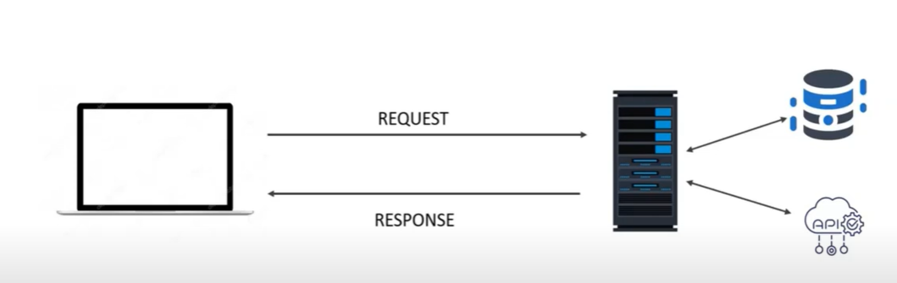
promise
When we request to server the server will
Take time to prepare data when it is prepared
Completely it is given to client .the data may
Be th error message also

Slide 3
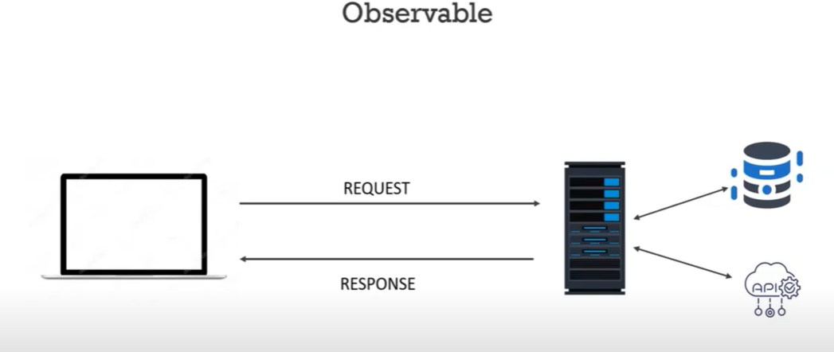
Observable
The observable will not wait till all the data is completely prepared
It creates a stream and delivers to subscribers if there is error
It is delievered to client

Slide 4
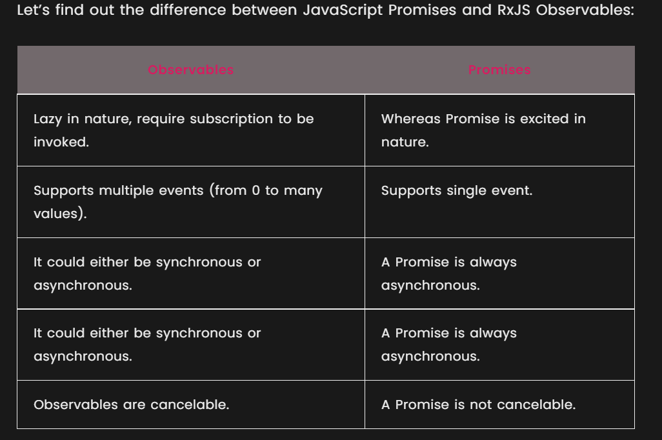

Slide 5
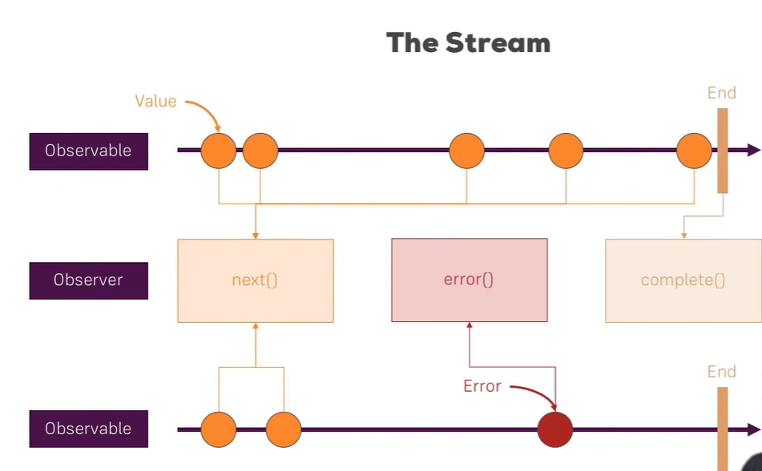

Slide 6
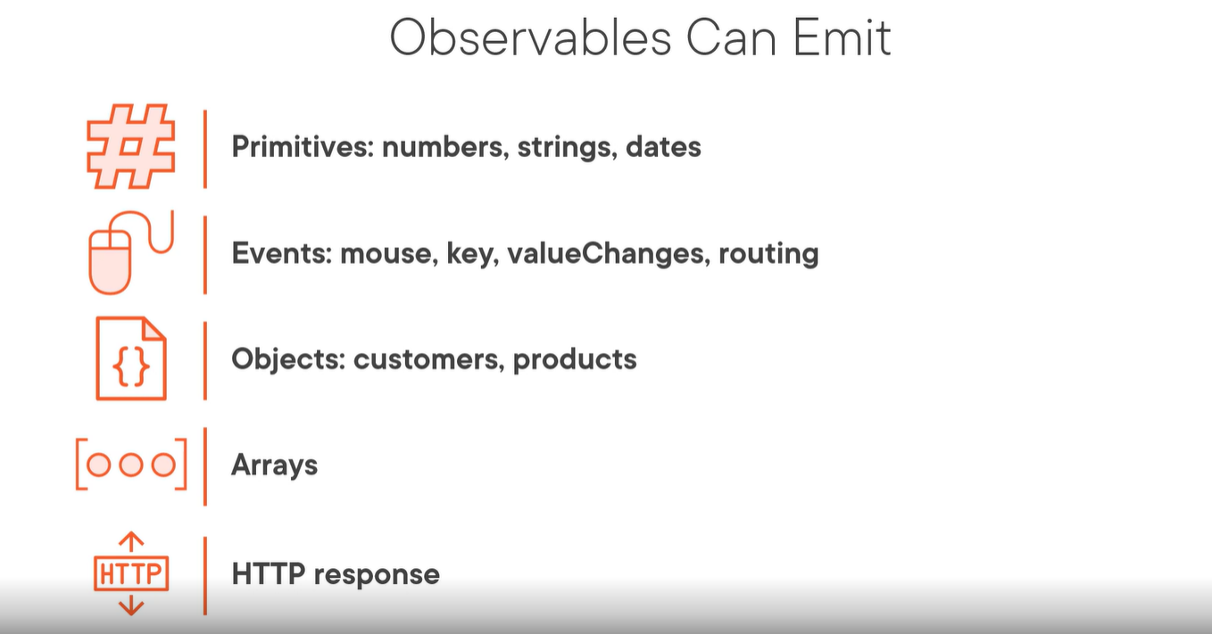

Slide 7
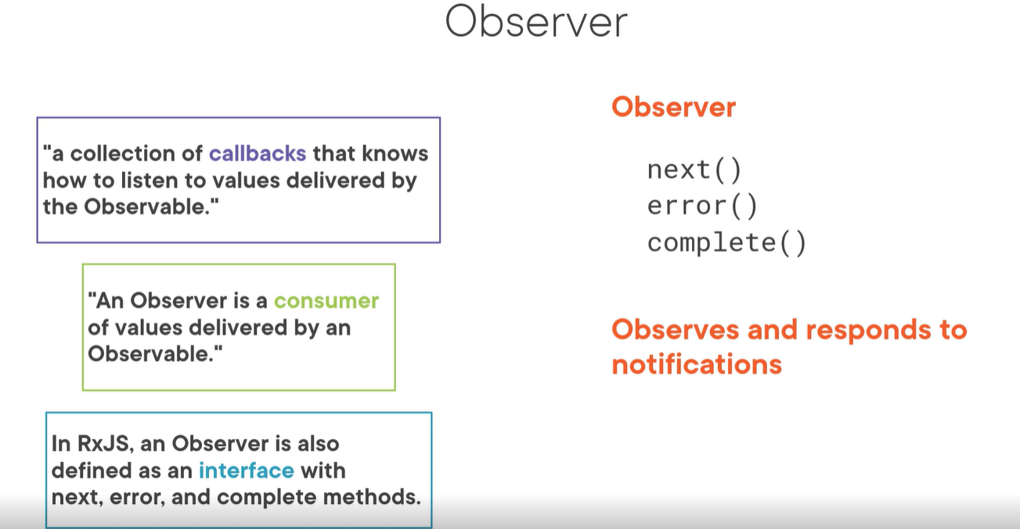

Slide 8
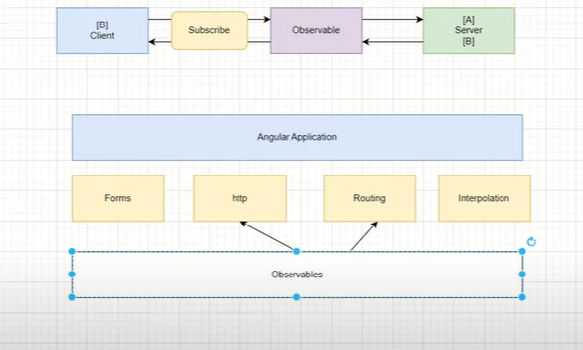

Slide 9
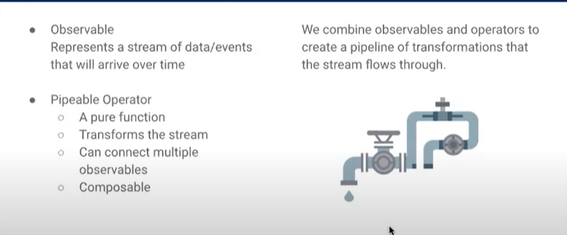
rxjs
What is RxJS
The RxJS (Reactive Extensions Library for JavaScript) is a javascript library, that allows us to work with asynchronous data streams
The Angular uses the RxJS library heavily in its framework to implement Reactive Programming. Some of the examples where reactive programming used are
Reacting to an HTTP request in Angular
Value changes / Status Changes in Angular Forms
The Router and Forms modules use observables to listen for and respond to user-input events.
You can define custom events that send observable output data from a child to a parent component.
The HTTP module uses observables to handle AJAX requests and responses.
The RxJs has two main players
Observable
Observers ( Subscribers)

Slide 10
Working with Observables in Angular
Observables are one of the most powerful and interesting concepts in Angular, which help us in working with asynchronous operations effectively.
An Observable works on a pub-sub model, where there are n number of clients which subscribe to one Subscription, and whenever a new value is available in the Subscription, all the subscribed clients to that Subscription are notified of the new value.
This process continues until the Subscription no longer receives a new value or the clients no longer need to be notified of the new values that the Subscription has. The former is when the Subscription is "Complete" and the later is when the client has "unsubscribed" from the notification

Slide 11
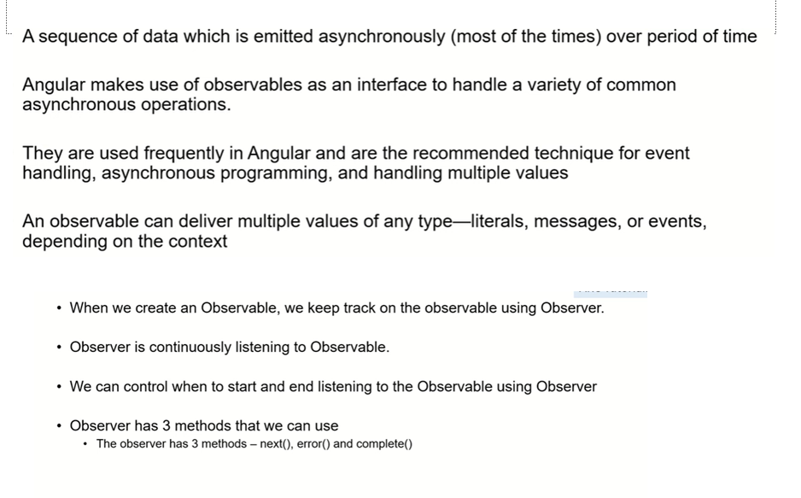

Slide 12
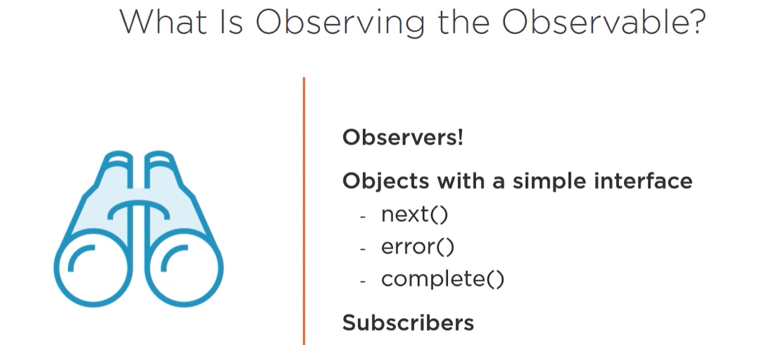

Slide 13
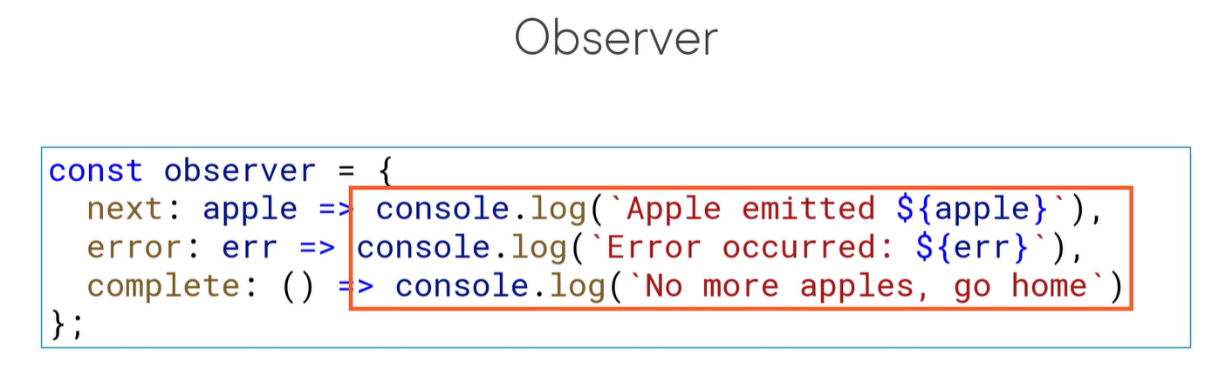
An observer is a object which will have 3
Callback functions

Slide 14
In making API calls using HttpClient where the client makes an asynchronous API call to the server and needs to be notified when the API call returns data.
In Reactive Forms where each time the form state changes or the user changes the input, the corresponding Model needs to be notified of the new state
In an event-based communication between two or more components where one component triggers an "Event" on another, and the other component "emits" new values for the caller component be notified of the changes.
In Routing, where the user can subscribe to the ActivatedRoute properties such as params, queryParams and so on to capture these properties.

Slide 15
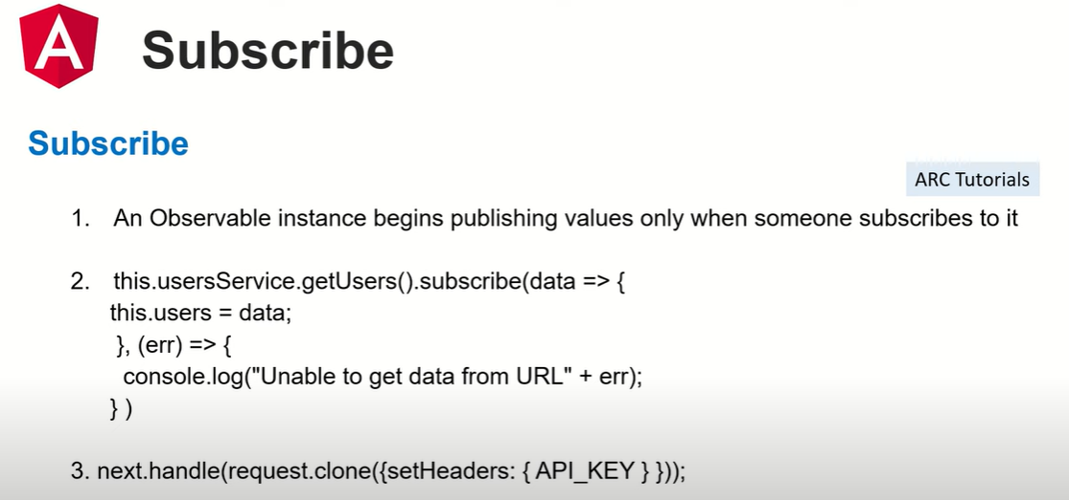

Slide 16
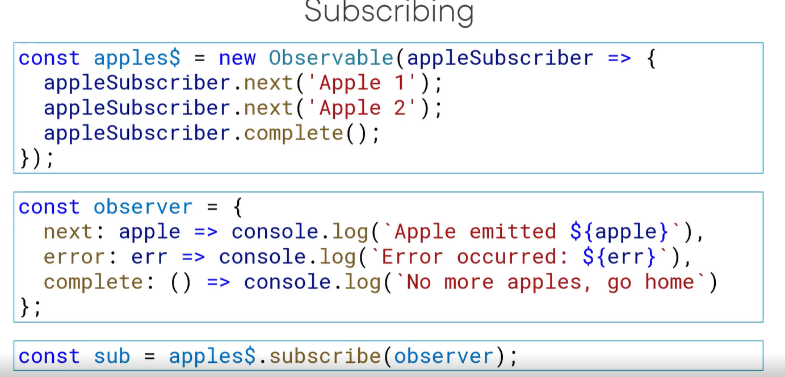
Function name as a parameter
$ says that it is a observable variable

Slide 17
import { Component, OnInit } from '@angular/core'; import {Observable} from 'rxjs'; @Component({ selector: 'app-next-example', templateUrl: './next-example.component.html', styleUrls: ['./next-example.component.css'] }) export class NextExampleComponent implements OnInit { constructor() { } ngOnInit() { // Create a new Observable const sqnc = new Observable(countOnetoTen); // Execute the Observable and print the // result of each notification // next() is a call to countOnetoTen method // to get the next value from the observable sqnc.subscribe({ next(num) { console.log(num); } });
// This function runs when subscribe()
// is called
function countOnetoTen(observer) {
for(var i = 1; i <= 10; i++) {
// Calls the next observable
// notification
observer.next(i); }
// Unsubscribe after completing
// the sequence
return {unsubscribe(){}};
}
}
}

Slide 18
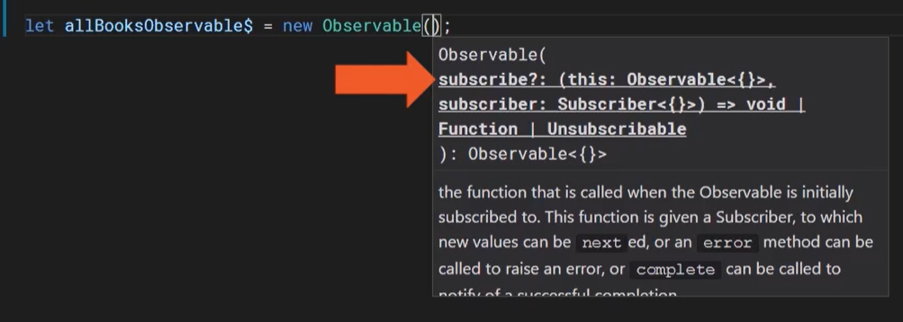
Creating observable
npm install rxjs

Slide 19
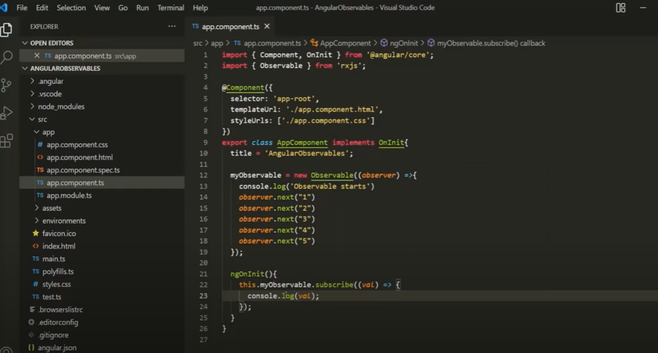

Slide 20
New syntax in rxjs6
import { Component, OnInit } from '@angular/core';
import { Observable ,from, interval} from 'rxjs';
import { ObjectUnsubscribedError, observable } from 'rxjs';
@Component({
selector: 'app-obsex1',
templateUrl: './obsex1.component.html',
styleUrls: ['./obsex1.component.css']
})
export class Obsex1Component implements OnInit {
constructor() { }
ngOnInit(): void {
const tentoone$:Observable<number>=new Observable((observer)=>{
;
for (let index = 10; index >1; index--)
{
observer.next(index);
//setTimeout(() => { observer.next(index) }, 4000);
}

Slide 21
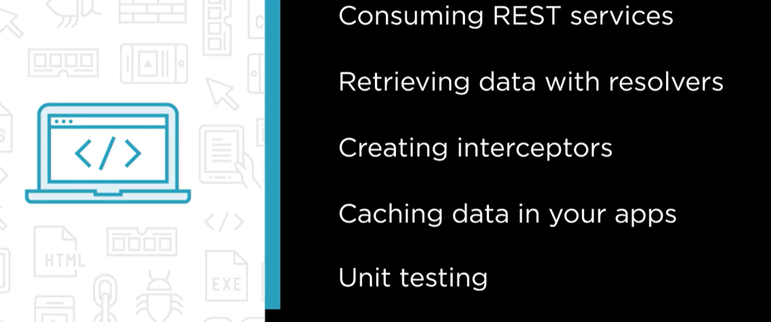

Slide 22

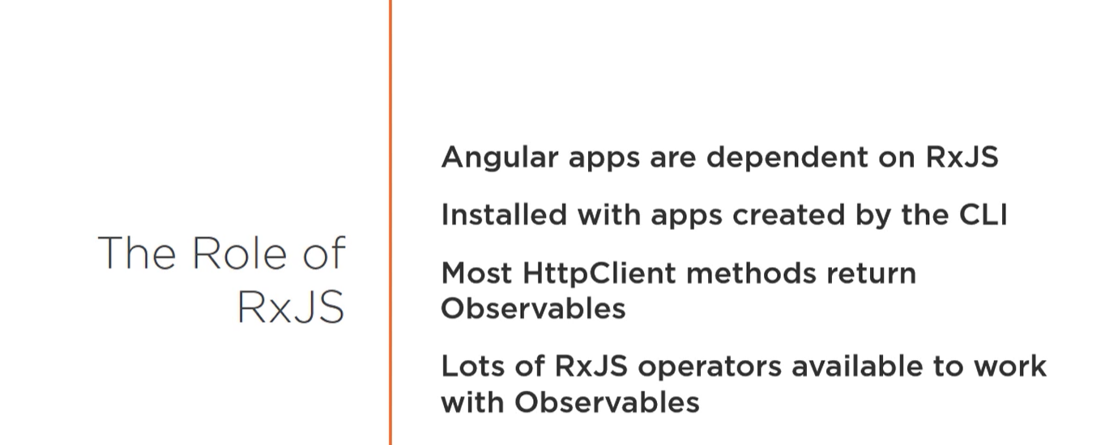

Slide 23
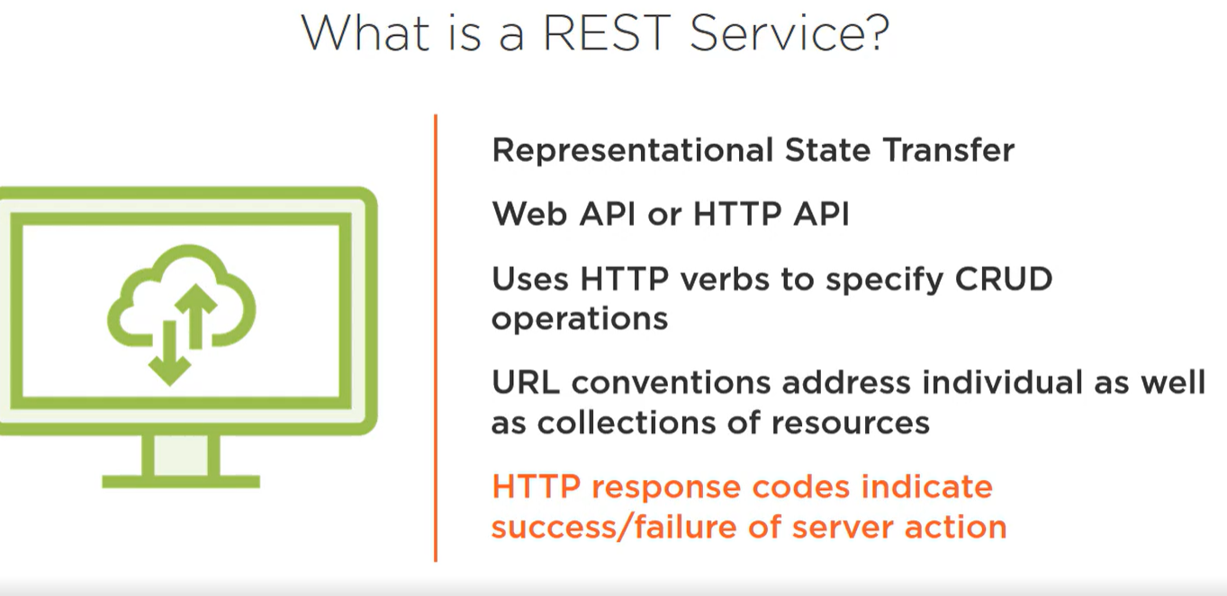

Slide 24
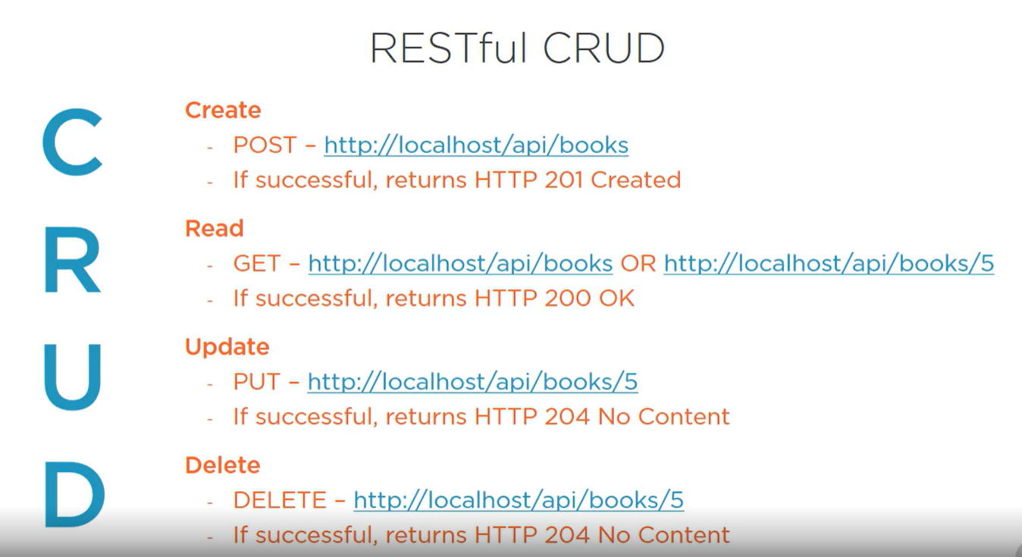

Slide 25
Why Angular HttpClient?
The HttpClient builtin service provides many advantages to Angular developers:
HttpClient makes it easy to send and process HTTP requests and responses,
HttpClient has many builtin features for implementing test units,
HttpClient makes use of RxJS Observables for handling asynchronous operations instead of Promises which simplify common web development tasks such as
- The concelation of HTTP requests,
- Listenning for the progression of file download and file upload operations,
- Easy error handling,
- Retrying failed HTTP requests, etc.

Slide 26
what is Angular HttpClient?
Front end applications, built using frameworks like Angular communicate with backend servers through REST APIs (which are based on the HTTP protocol) using either the XMLHttpRequest interface or the fetch() API.
Angular HttpClient makes use of the XMLHttpRequest interface that supports both modern and legacy browsers.
The HttpClient is available from the @angular/common/http package and has a simplified API interface and powerful features such as easy testability, typed request and response objects, request and response interceptors, reactive APIs with RxJS Observables, and streamlined error handling.

Slide 27
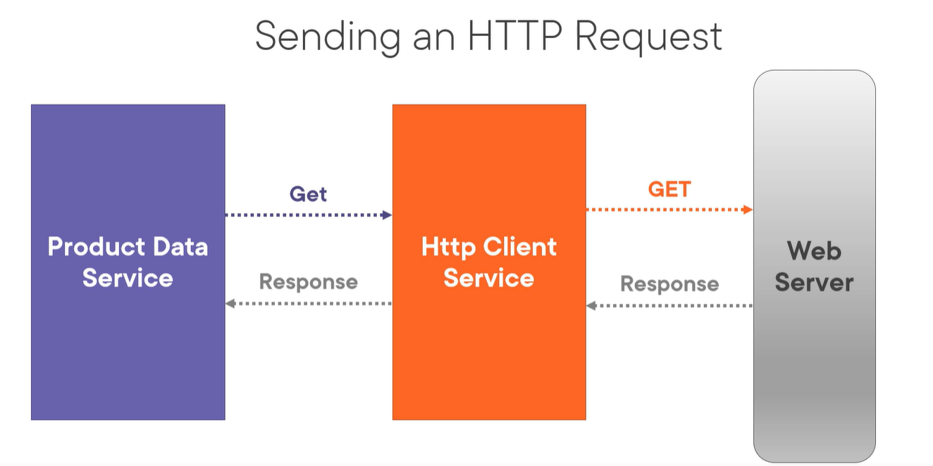

Slide 28
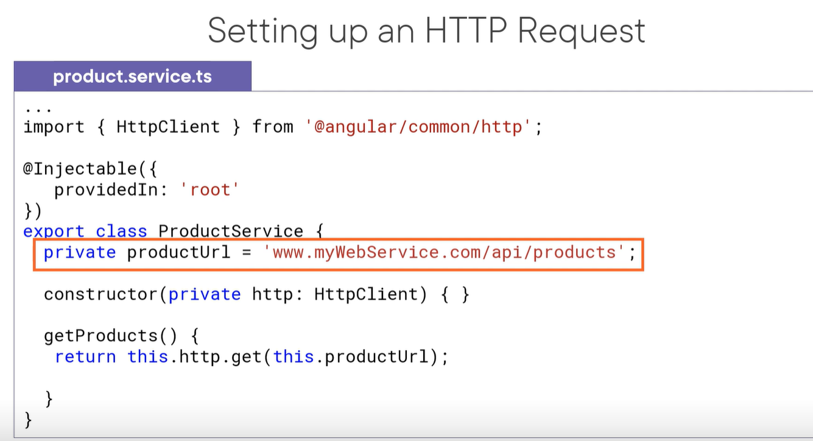

Slide 29
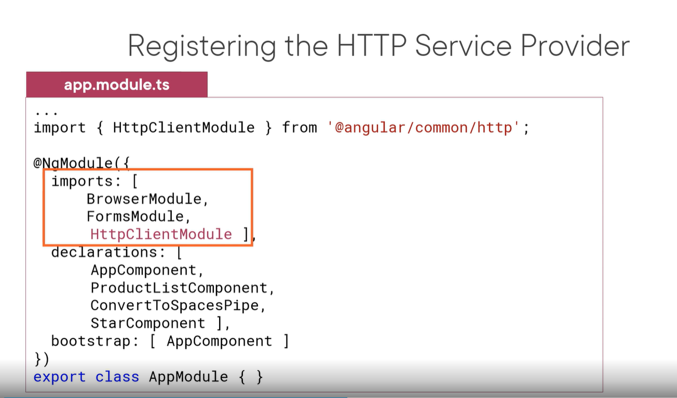

Slide 30
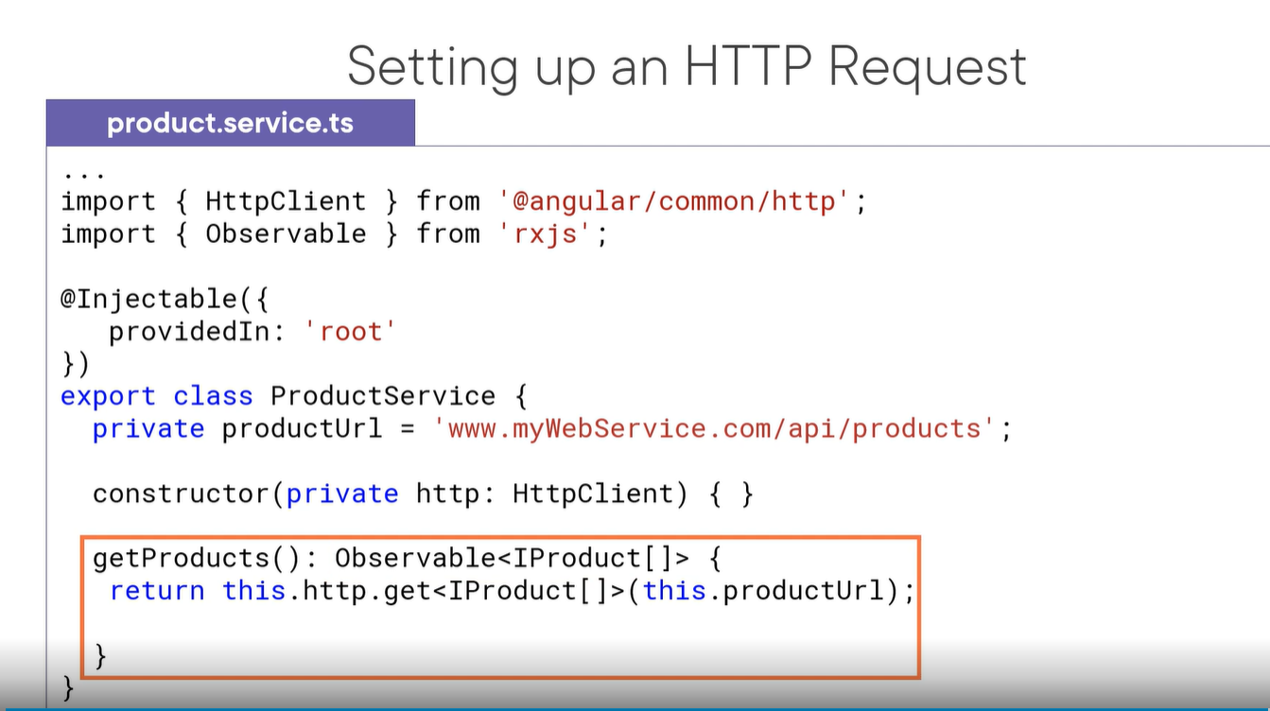

Slide 31
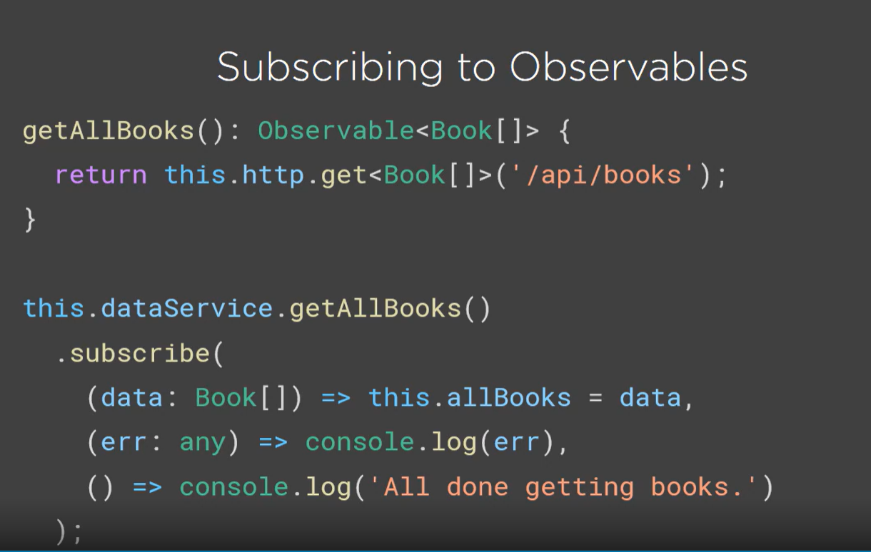

Slide 32
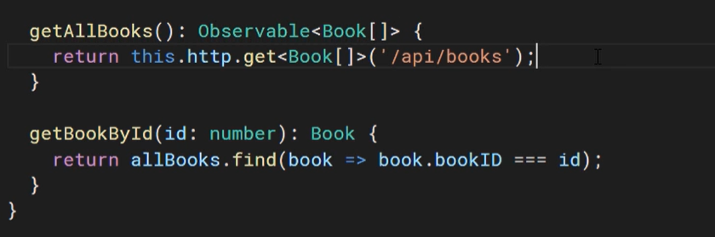
Service.ts

Slide 33
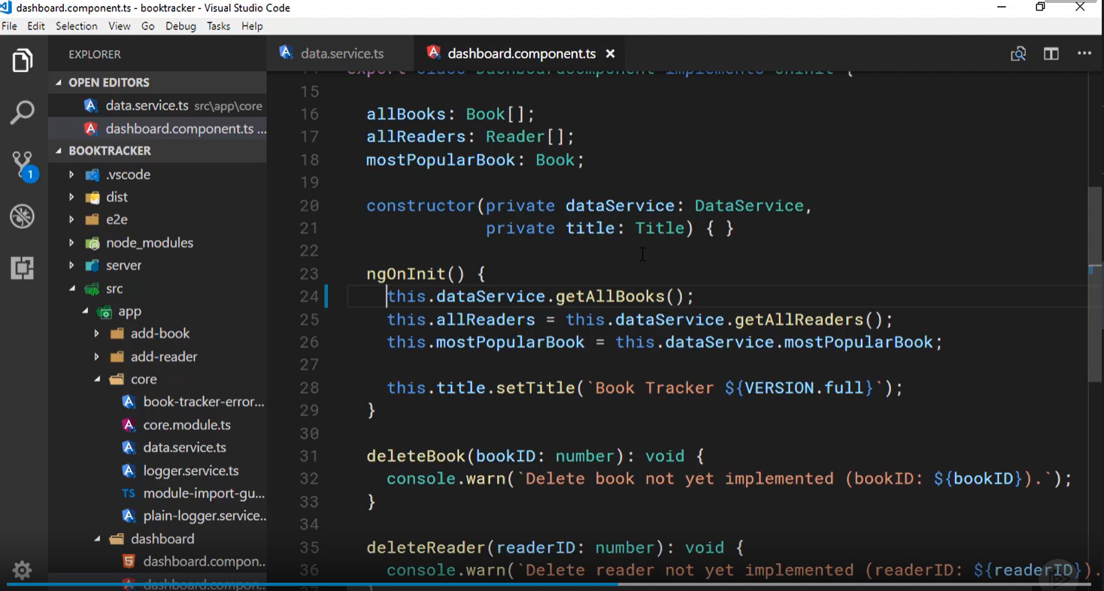

Slide 34
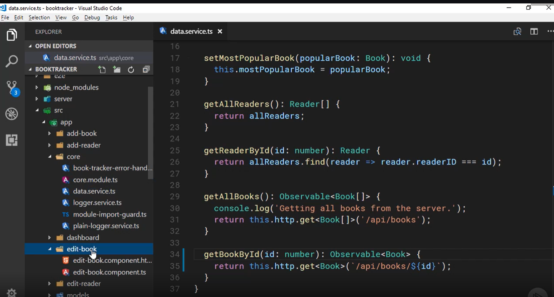
Edit book

Slide 35
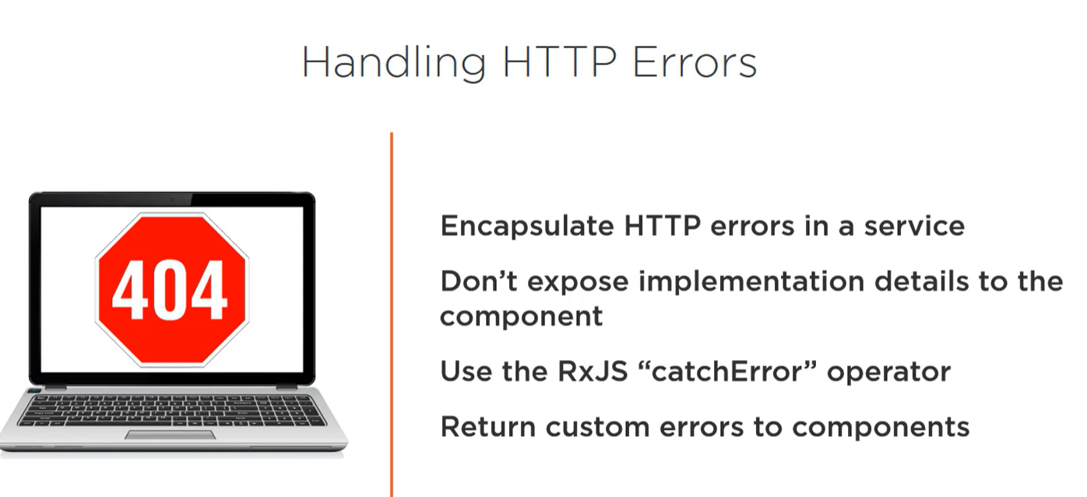

Slide 36
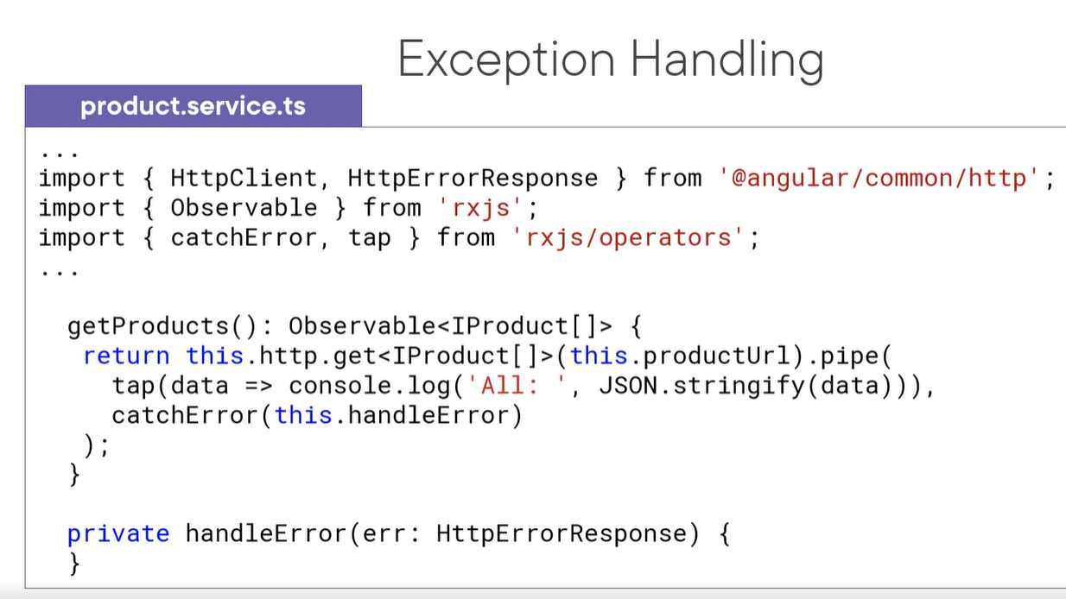

Slide 37
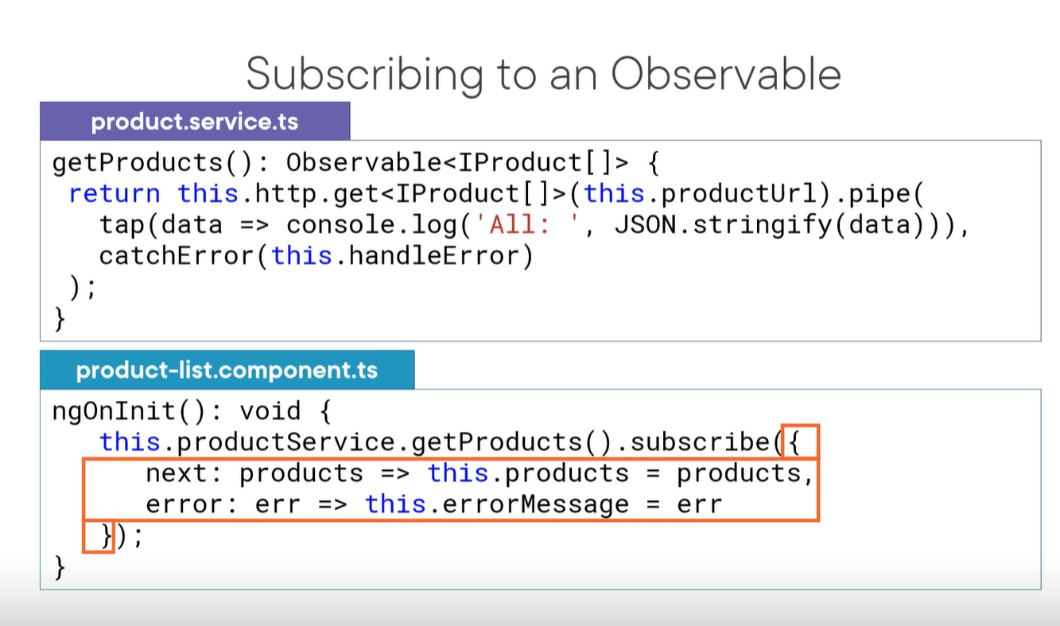

Slide 39
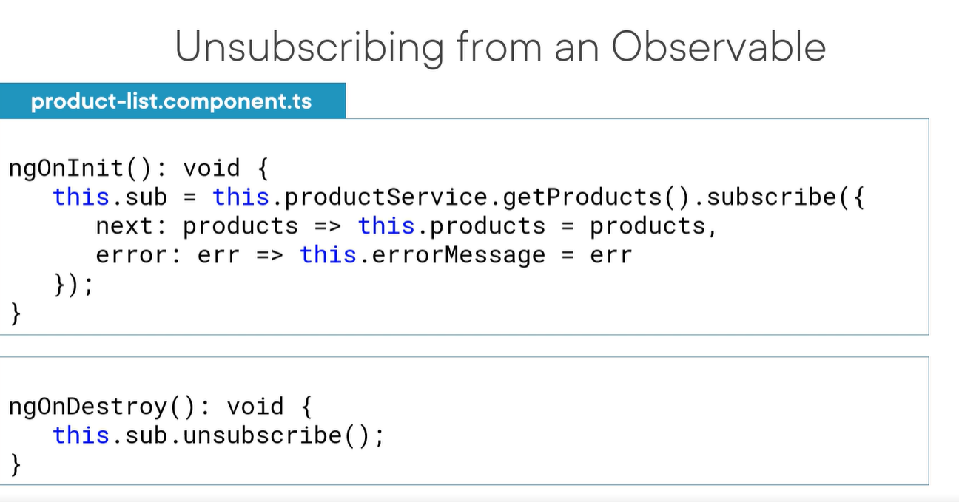

Slide 40
